Slide 1
CS 6360: Advanced Artificial Intelligence Lecture 6 Adversarial Search: MCTS
Gautam Biswas
Spring 2017

Slide 2
Outline of Lecture
State of the Art of Computer Games
Chess
Checkers
Other games: Othello, Connect Four
Most Challenging: Go
Monte Carlo Tree Search

Slide 3
Types of Games
 | deterministic | chance
perfect information | chess, checkers, connect four, othello | backgammon
imperfect information |  | bridge, poker, scrabble

Slide 4
State of the Art: Games
Checkers: Big breakthrough in AI: Samuels in 1952 at IBM developed Checkers program that played itself thousands of times and learnt its own evaluation functions. Evaluation function used is a weighted sum of a set of functions.
Samuel, A. L. (1959). Some studies in machine learning using the game of checkers. IBM Journal of research and development, 3(3), 210-229.
Best checkers programs now – as good as human champions
Best know Chinook – it’s creators claim Checkers is a solved game.
1992: Marion Tinsley (World Checkers Champion): 4-2 over Chinook; 33 draws
1994: 6 games (all draws) – Tinsley withdrew health reasons
Since then Chinook has defended title twice …..

Slide 5
Checkers: CHINOOK
CHINOOK’s performance has four aspects:
Search algorithms for traversing through the O(10²⁰) search space
Parallel alpha-beta search runs on 16-processor machine
Minimum search depth = 19
Cut off search (unproductive quiescent states), & continue search selectively on other paths to greater depths
Where will heuristic function make gross errors
Find such positions, find common features defining such positions
Form patterns, stored as tactical tables – reduced errors in evaluation function by 75%

Slide 6
Checkers: CHINOOK
CHINOOK – Aspects 2 and 3
evaluation function, decisions about how good a position is
Linear combination of roughly two dozen major components, each of which contains several heuristic weights
Weights learned using genetic algorithms & neural nets
However, hand tuning still more effective
end-game databases, perfect information on which endgame positions are won, lost, and drawn
all positions with seven or fewer pieces on the board; later all of the eight-piece end games.
databases contained roughly 40 billion positions compressed into 2 gigabytes of data.
.

Slide 7
Checkers: CHINOOK
CHINOOK – Aspect 4
opening book, a database of opening lines to start a game
Best sequence of opening moves reported in the literature
Find surprises in the openings (cooks)
Advantage of computer program – can run lot of verifications
Can use machine learning to learn patterns
Even after all of this programming bugs were found that were near fatal

Slide 8
Chinook
References
Schaeffer, J., Lake, R., Lu, P., & Bryant, M. (1996). CHINOOK the world man-machine checkers champion. AI Magazine, 17(1), 21.
Schaeffer, J., Culberson, J., Treloar, N., Knight, B., Lu, P., & Szafron, D. (1992). A world championship caliber checkers program. Artificial Intelligence, 53(2-3), 273-289.

Slide 9
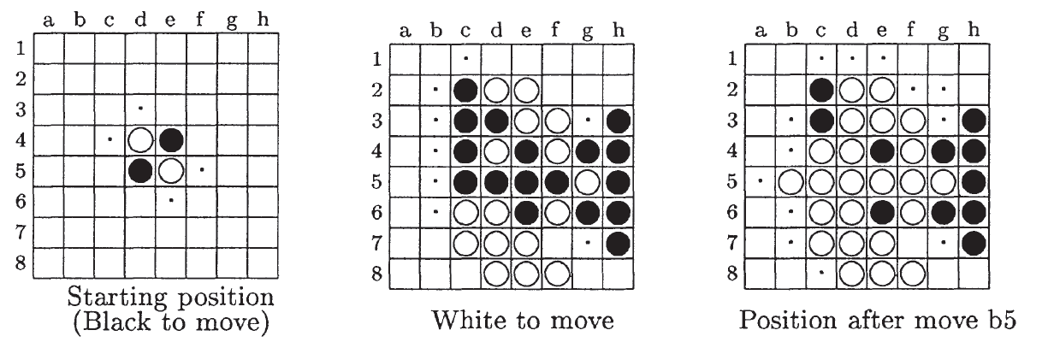
Othello
Othello
Ref: Buro, M. (2003). The evolution of strong Othello programs. In Entertainment Computing (pp. 81-88). Springer US.
Logistello: beat human world champion 6:0 in 1997
Computer Othello has surpassed human abilities

Slide 10
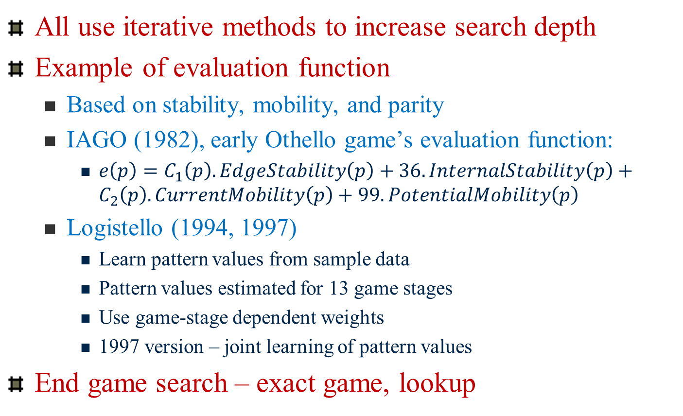
Othello
All use iterative methods to increase search depth
Example of evaluation function
Based on stability, mobility, and parity
IAGO (1982), early Othello game’s evaluation function:
$e\left(p\right)=C_{1}\left(p\right).EdgeStability\left(p\right)+36.InternalStability\left(p\right)+C_{2}\left(p\right).CurrentMobility\left(p\right)+99.PotentialMobility\left(p\right)$
Logistello (1994, 1997)
Learn pattern values from sample data
Pattern values estimated for 13 game stages
Use game-stage dependent weights
1997 version – joint learning of pattern values
End game search – exact game, lookup

Slide 11
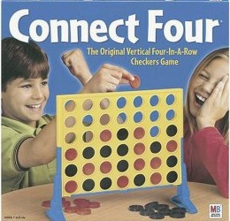
Game of Connect Four
Two player game, each player has 21 chips
6 × 7 vertical board
First player with 4 of his/her connected chips (row, column, or diagonal) wins
Can implement mini-max with alpha-beta pruning
Number of heuristic evaluation functions
Allen and Allis have discovered strategic rules that has solved this game
First player can always win

Slide 12
Connect Four
Websites of interest
Rules of Connect4 and links to strategies
You can play Connect 4 with a computer here.
Additional websites:
Victor Allis’ MS Thesis: http://www.informatik.uni-trier.de/~fernau/DSL0607/Masterthesis-Viergewinnt.pdf
Useful Connect Four website: http://gizmodo.com/heres-how-to-win-every-time-at-connect-four-1474572099

Slide 13
Go
Go: branching factor of game > 300, so straight search doesn’t work. Have to use pattern knowledge bases.
Did not match up to human champions for a long time
Ref: Lee, C. S., Wang, M. H., Chaslot, G., Hoock, J. B., Rimmel, A., Teytaud, O., ... & Hong, T. P. (2009). The computational intelligence of MoGo revealed in Taiwan's computer Go tournaments. IEEE Transactions on Computational Intelligence and AI in games, 1(1), 73-89.
Recently, computer program AlphaGo beat world Go champion
https://www.scientificamerican.com/article/how-the-computer-beat-the-go-master/
Assignment 2: Computer program for playing the game of Hex

Slide 14
State of the Art: Games
Backgammon: 2 dice ≈ 20 legal moves (can be 6000 with 1-1 roll)
depth 4 =
as depth increases, probability of reaching nodes decreases, so value of lookahead is diminshed.
(alpha-beta not a great idea).
best backgammon game: uses depth 2 search + very good eval. fn.
plays at world championship level.

Slide 15
Summary: Traditional Game Searches
Alpha-Beta
With additional cut-offs defined by evaluation function and pattern definitions
UCT (Upper Confidence bounds applied to Trees) Search
Monte Carlo Tree search
Explore most promising moves & random sampling
Play game many times – play till complete
UCT
MCTS repeated multiple times

Slide 16
What about all these new games?
War games (look up computer games website)
Red Alert, Diablo II
Complex games, but based on fixed strategies
Soon player finds out fixed strategy – can play against it
What about the next level of games?
Introduce intelligent agents: have memory, can remember what the player did the last time – change strategy based on context; use learning techniques; use fuzzy rules
Educational Games
Example: The Sims
Look up website: http://www.gameai.com/

Slide 17
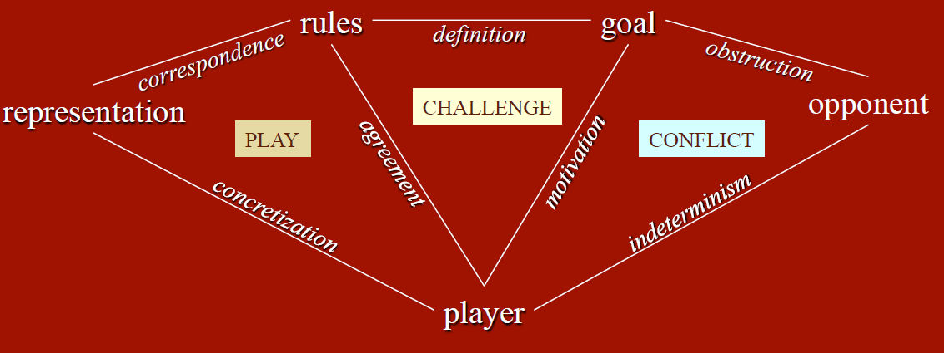
Components, Reslationships, Aspects of Game
From Jouni Smed & Harri Hakonen: Algorithms and Networking for Computer Games, John Wiley & Sons, 2006.

Slide 18
Extend state of the art: War Games
Real time strategy (RTS) video games
Traditional AI methods are too slow
Human players dominate RTS (Real Time Strategy) (games) AI systems
Battles with hundreds of agents
Multi-agent planning systems
Solutions are computationally intractable
Have to find approximate solutions
Solutions: Time Critical
Buro, M. (2003). Real-time strategy games: A new AI research challenge. In IJCAI (pp. 1534-1535).

Slide 19
Game: StarCraft
Challenges
How to quickly navigate groups of units on large maps, while staying in formation?
How to deal with imperfect information, such as unknown opponent locations?
How to cooperate well with team members?
How to detect and exploit opponent weaknesses?
How to coordinate attacks involving dozens of units?

Slide 20
RTS Game Strategy
Two levels
Macro – economic development, technology advancement
Micro – obstacle avoidance, unit targeting in combat

Slide 21
Monte Carlo Tree Search (MCTS)
Traditional Methods
Minimax (alpha-beta)
Need evaluation function, anytime algorithm
Drawbacks
The number of moves to be analyzed quickly increases in depth.
Depth searched limited by computation power

Slide 22
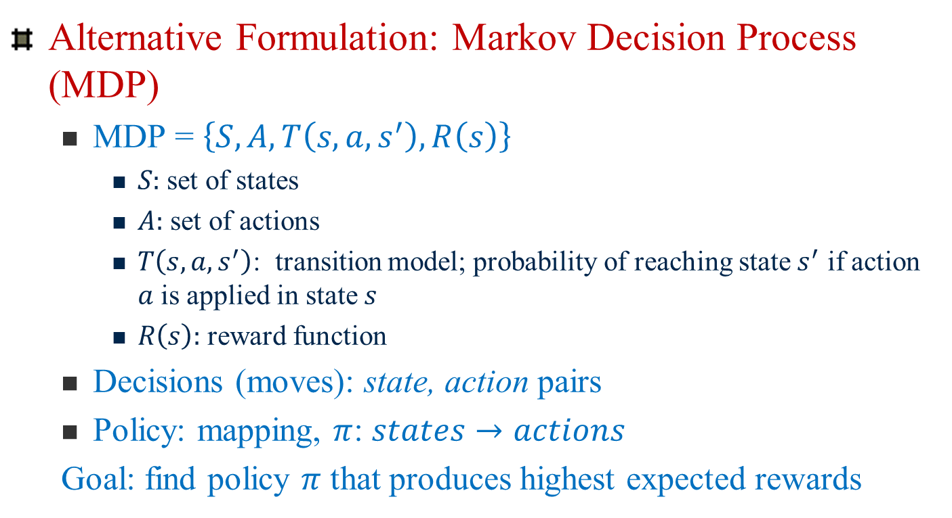
MCTS
Alternative Formulation: Markov Decision Process (MDP)
MDP = $\left\{S,A, T\left(s,a,s^{′}\right),R\left(s\right)\right\}$
$S:$set of states
$A:$ set of actions
$T\left(s,a,s^{′}\right)$: transition model; probability of reaching state $s^{′}$ if action $a$ is applied in state $s$
$R\left(s\right):$ reward function
Decisions (moves): state, action pairs
Policy: mapping, $π$: $states→actions$
Goal: find policy $π$ that produces highest expected rewards

Slide 23
MCTS
Remember, we are dealing with games that are
zero sum, perfect information, deterministic, discrete, and sequential
Examples, Tic-Tac-Toe, Connect Four, Othello, Checkers, Chess, Go

Slide 24
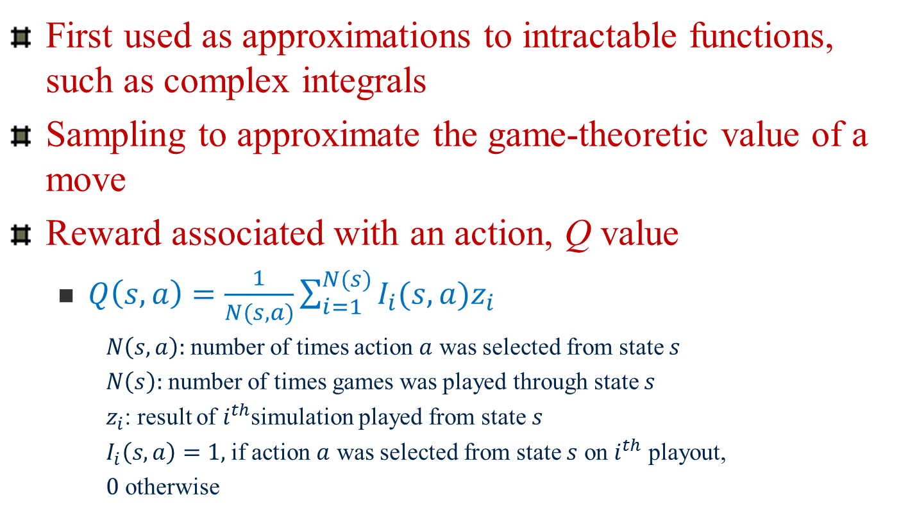
Monte Carlo methods
First used as approximations to intractable functions, such as complex integrals
Sampling to approximate the game-theoretic value of a move
Reward associated with an action, Q value
$Q\left(s,a\right)=\frac{1}{N(s,a)}\sum_{i=1}^{N(s)}{I_{i}(s,a)z_{i}}$
$N\left(s,a\right):$number of times action $a$ was selected from state $s$
$N\left(s\right):$ number of times games was played through state
: result of $i^{th}$simulation played from state $s$
$I_{i}\left(s,a\right)=1,$if action $a$ was selected from state $s$ on $i^{th}$ playout,
$0$ otherwise
Improvements: can bias action selection

Slide 25
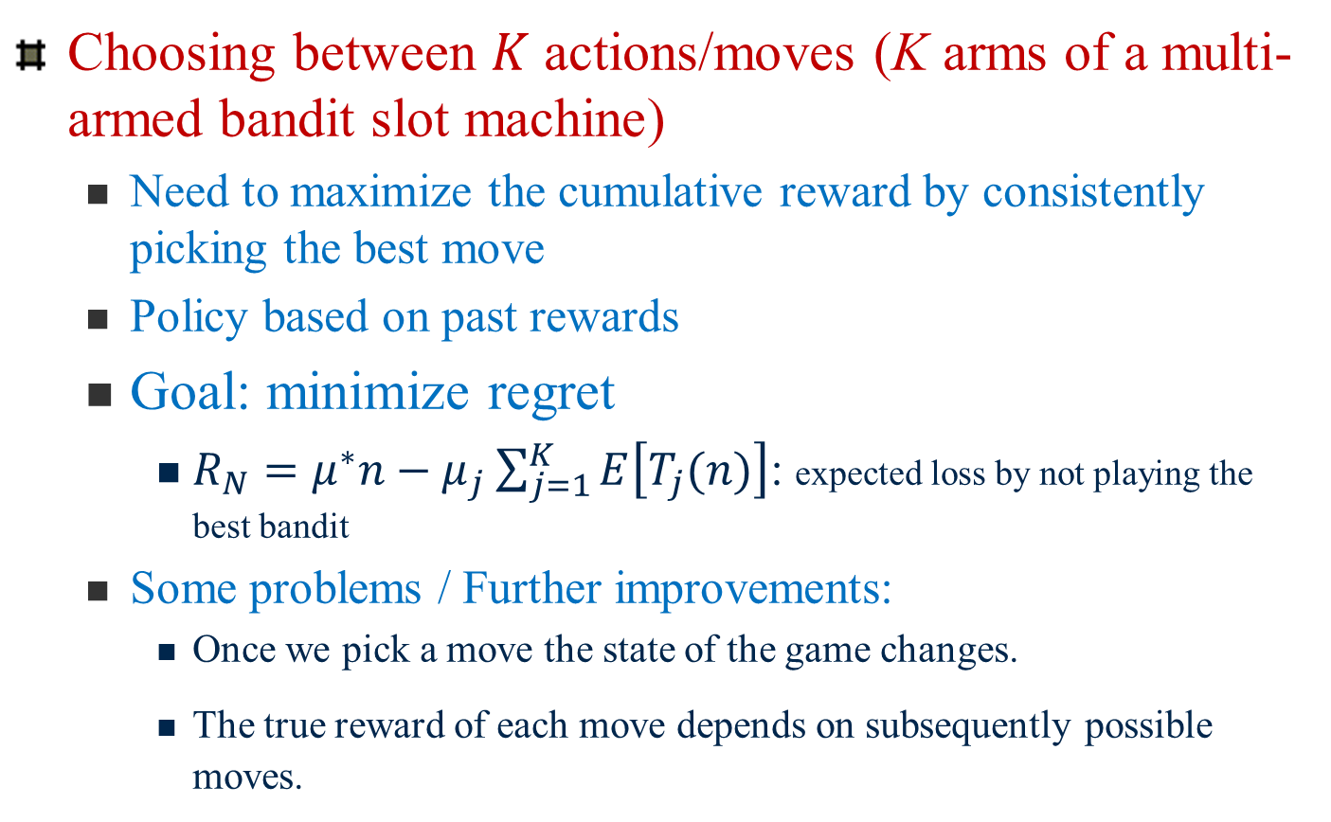
Bandit-Based Methods
Choosing between $K$ actions/moves (K arms of a multi-armed bandit slot machine)
Need to maximize the cumulative reward by consistently picking the best move
Policy based on past rewards
Goal: minimize regret
$R_{N}=μ^{∗}n−μ_{j}\sum_{j=1}^{K}{E\left[T_{j}(n)\right]}$: expected loss by not playing the best bandit
Some problems / Further improvements:
Once we pick a move the state of the game changes.
The true reward of each move depends on subsequently possible moves.

Slide 26
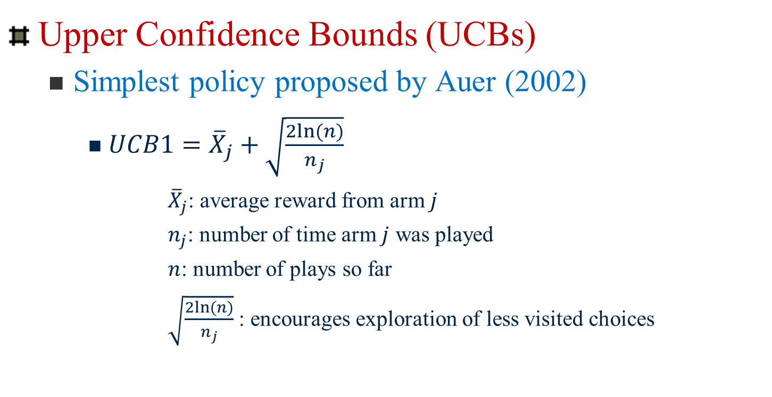
Bandit-based Methods
Upper Confidence Bounds (UCBs)
Simplest policy proposed by Auer (2002)
$UCB1={\overline{X}}_{j}+\sqrt{\frac{2ln⁡(n)}{n_{j}}}$
${\overline{X}}_{j}$: average reward from arm $j$
$n_{j}$: number of time arm $j$ was played
$n$: number of plays so far
$\sqrt{\frac{2ln⁡(n)}{n_{j}}}$ : encourages exploration of less visited choices
Balance between exploration and exploitation
Basis for MCTS

Slide 27
MCTS -- overview
Two Fundamental Concepts:
The true value of any action can be approximated by running several random simulations.
These values can be efficiently used to adjust the policy (strategy) towards a best-first strategy
Builds a partial game tree before each move. Then selection is made.
Moves are explored and values are updated/estimated.

Slide 28
General Applications
Numerical Algorithms
AI Games
Particularly games with imperfect information
Scrabble/Bridge
Also very successful in Go (We will hear more about this later)
Many other applications
Real World Planning
Optimization
Control Systems

Slide 29
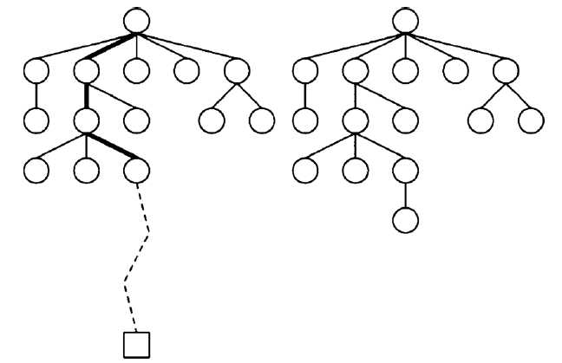
Basic MCTS process
Iteratively build partial search tree
Iteration
Most urgent node
Tree policy
Exploration/exploitation
Simulation
Add child node
Default policy
Update weights
Exploitation
(look in areas that appear to be promising)
Exploration
(look in areas not well-sampled yet)
Values of intermediate states do not have to be updated
Requires less domain knowledge

Slide 30
MCTS – notes
Kocsis and Szepesvári, 2006
Formally describing bandit-based method
Simulate to approximate reward
Proved MCTS converges to minimax solution
UCB1: finds optimal arm of upper confidence bound (UCT employed UCB1 algorithm on each explored node)

Slide 31
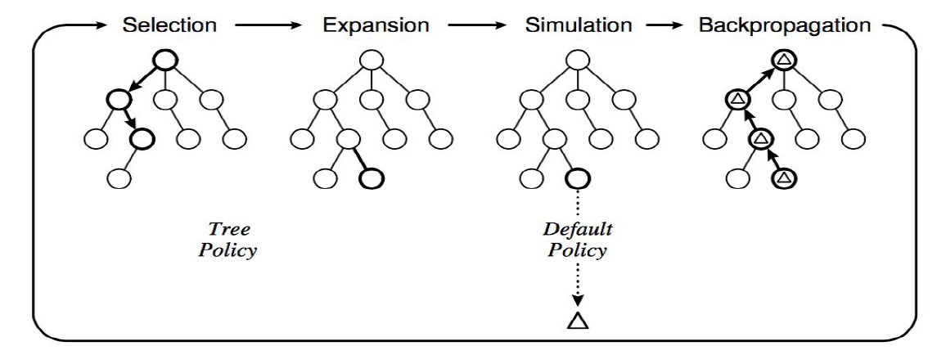
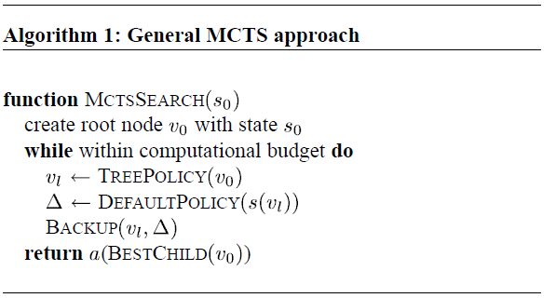
MCTS Algorithm overview

Slide 32
Next Class
Finish up UCT algorithm (pp. 6-8)
Present Assignment 2: Playing the game of Hex
Next Topic:
Constraint Satisfaction Search

Slide 33
Policies
Policies are crucial for how MCTS operates
Tree policy
Used to determine how children are selected
Default policy
Used to determine how simulations are run (ex. randomized)
Result of simulation used to update values

